Slide 1

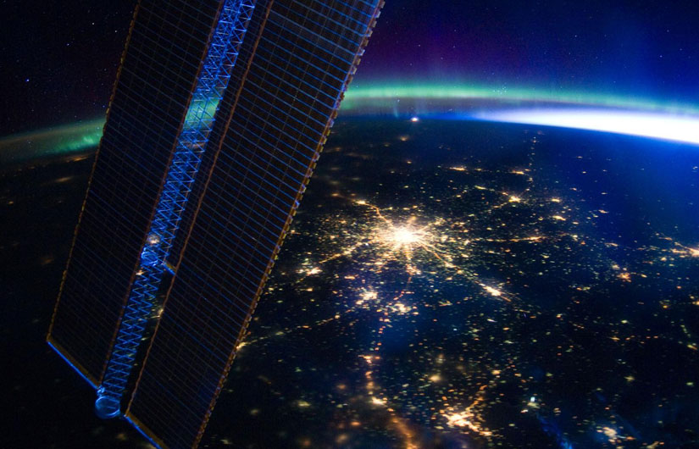
Application of
Google Earth Engine
in
Agriculture Water Management
Dr. A.K. Lohani
Scientist G
National Institute of Hydrology
Roorkee

Slide 2



Google Earth Engine
Google Earth
Geospatial Analysis
3-D Globe Visualization

Slide 3
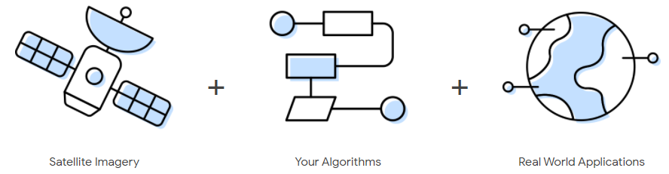
Google Earth Engine

Slide 4
What is Earth Engine?
Remote Sensing Archive
A cloud-based geospatial processing platform
Source: Google Earth Engine Slides

Slide 5
Why is it such a powerful image analysis software?
Public data catalog: vast amounts of publicly available data (you don’t need to store data)
Processing power (computation engine)
Interactive development platforms
Save and share work routines
A simplified system architecture diagram Gorelick et al. (2017)

Slide 6
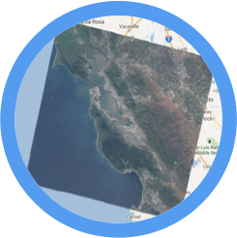

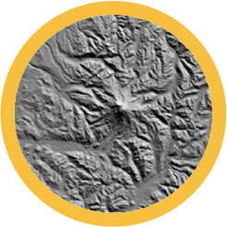
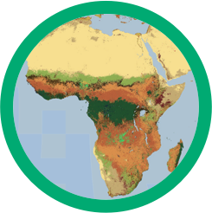


Why use Google Earth Engine?
Planetary-scale science, Free cloud processing with built-in functions, Massive online public data archive, Upload your own data and Flexible access through APIs (JavaScript & Python)
Geospatial
Datasets
add
mosaic
filter
distance
join
Algorithmic
Primitives
Requests
focal_min
convolve
Results
reduce
Storage and Compute

Slide 7
The Earth Engine Public Data Catalog
Landsat 4, 5, 7, 8
Raw, TOA, SR, ...
MODIS
Daily, NBAR, LST, ...
Terrain
SRTM, GTOPO, NED, ...
Land Cover
GlobCover, NLCD, ...
Atmospheric
NOAA NCEP, OMI, ...
... and many more, updating daily!
> 200 public datasets
> 4000 new images every day
> 5 million images
> 5 petabytes of data

Slide 8
Climate Data in GEE
Temperature:
MODIS, ASTER, and AVHRR
Climate:
Historical reanalysis data from NCEP/NCAR, gridded meteorological datasets like NLDAS-2, and GridMET, and climate model outputs like the University of Idaho MACAv2-METDATA and the NASA Earth Exchange’s Downscaled Climate Projections.

Slide 9
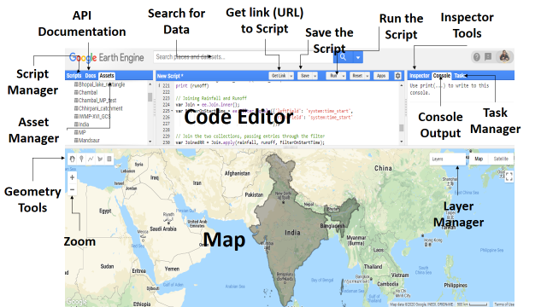
Components of Earth Engine Editor

Slide 10
API
GEE JavaScript API vs Python API
JavaScript Code Editor
Rich documentation & tutorials
Easy to get started
Built-in interactive mapping functionality
Built-in authentication
Earth Engine Apps
Can’t Install additional package
GEE Python API
Limited documentation & tutorials
Easier language syntax
Easy to share code between scripts
Batch Processing
More IDEs with debugging capability
Numerous Python packages
Many plotting & visualisations options
Integration with open sources GIS

Slide 11

How Does it work?

Slide 12

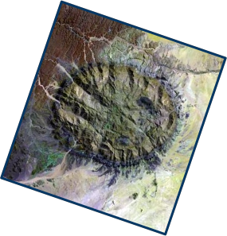
Global-scale
Algorithm
Processing
Get
an
Image
Pick your: projection, resolution, bands, bounding-box, visualization
Access as: Web map, KML, GeoTIFF

Slide 13
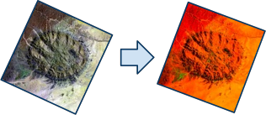
Global-scale Algorithm Processing
Get an Image
Apply
an
algorithm
to
an
image
Library functions or script your
own.

Slide 14
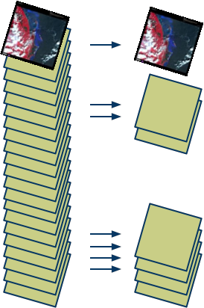
Global-scale Algorithm Processing
Get an Image
Apply an algorithm
to
an
image
Filter
a
collection
Time, Space & Metadata
search

Slide 15
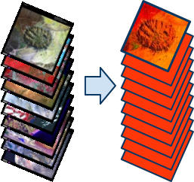
Global-scale Algorithm Processing
Get an Image
Apply an algorithm to an
image
Filter a collection
Map
an
algorithm
over
a
collection
N → N

Slide 16
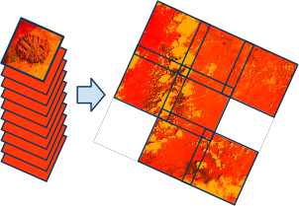
Global-scale Algorithm Processing
Get an Image
Apply an algorithm to an
image
Filter a collection
Map an algorithm over
a
collection
Reduce a collection
N → 1 or N → M

Slide 17
Global-scale Algorithm Processing
Get an Image
∑
Apply an algorithm to an
image
Filter a collection
Map an algorithm over a
collection
Reduce a collection
Compute an aggregate

Slide 18

Global-scale Algorithm Processing
Get an Image
Apply an algorithm to an
image
Filter a collection
Map an algorithm over a
collection
Reduce a collection
Compute an aggregate
Perform vector operations

Slide 19
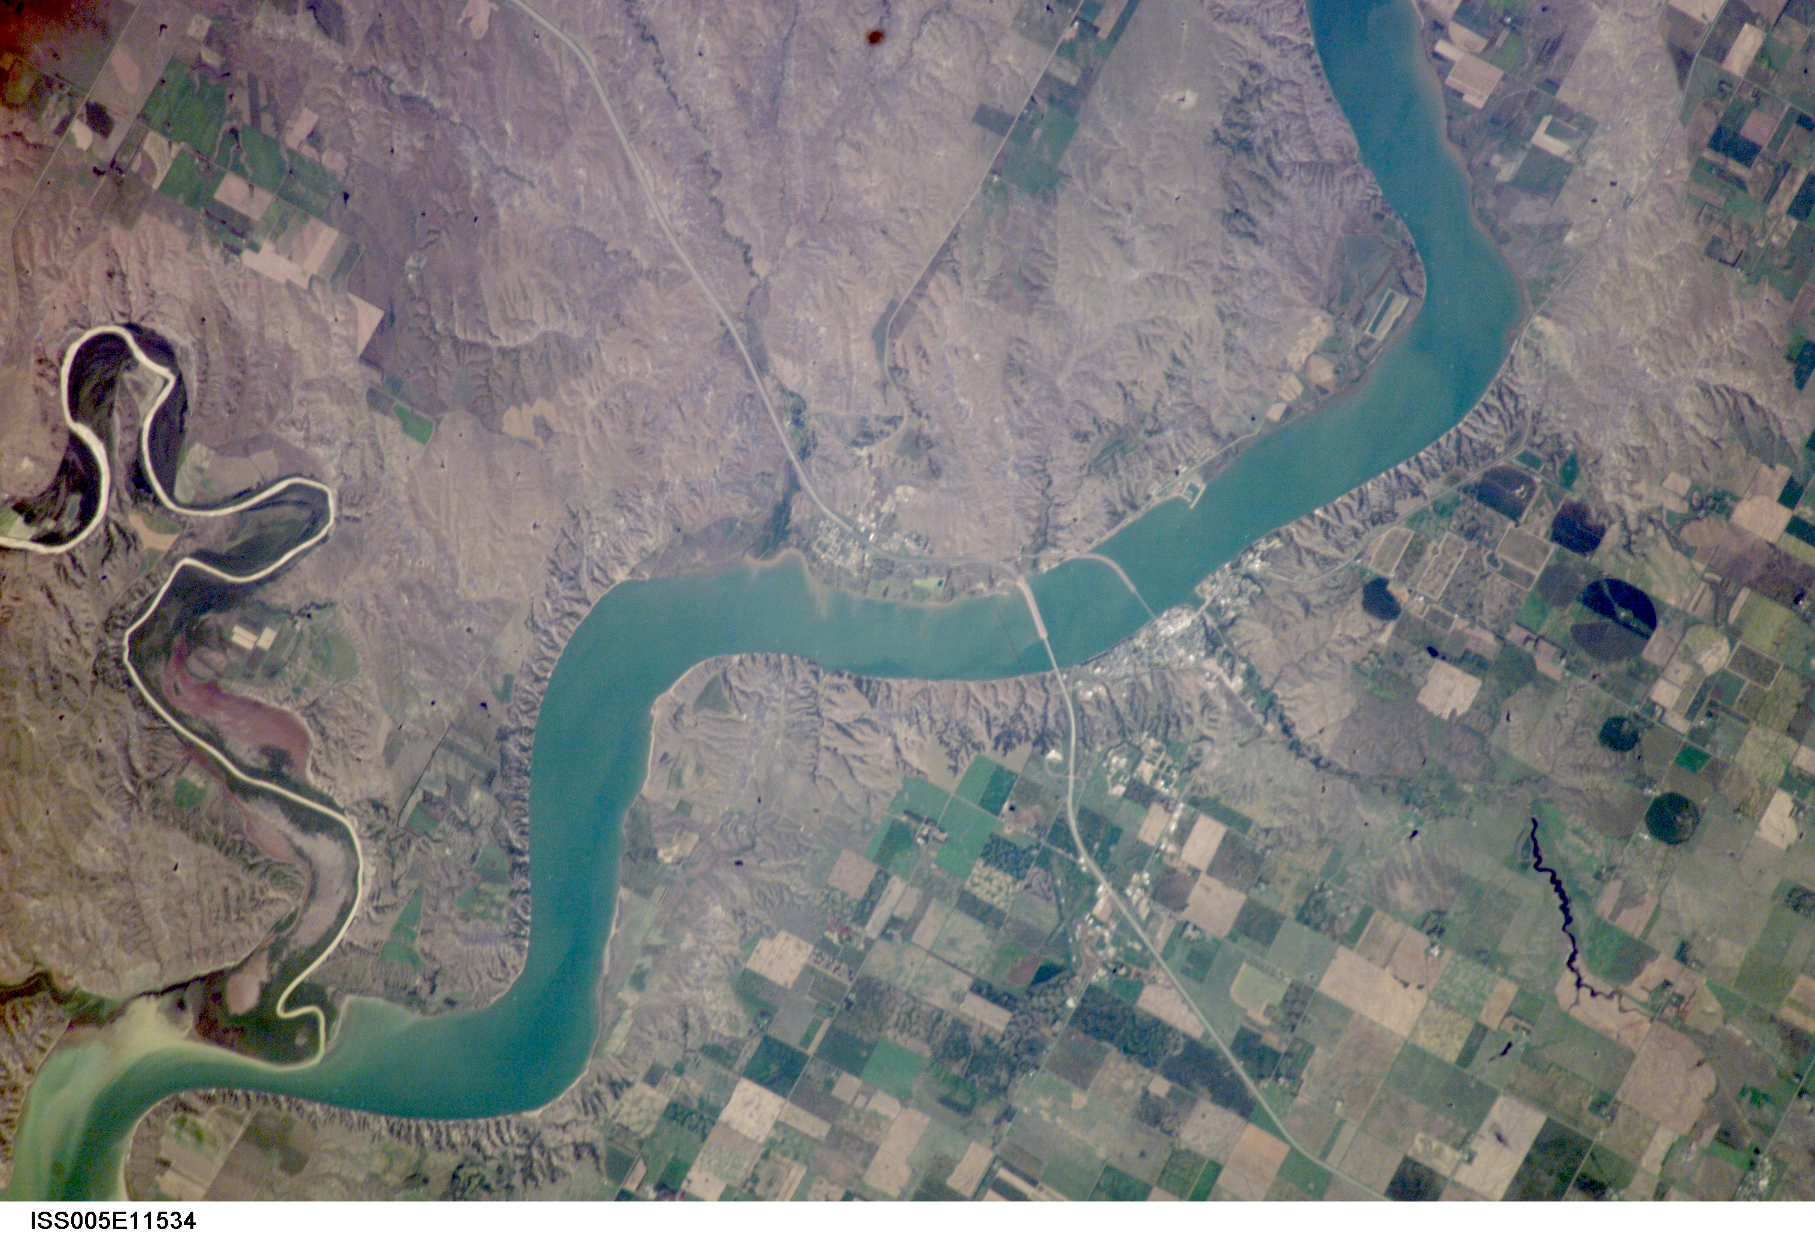
Case Studies

Slide 20
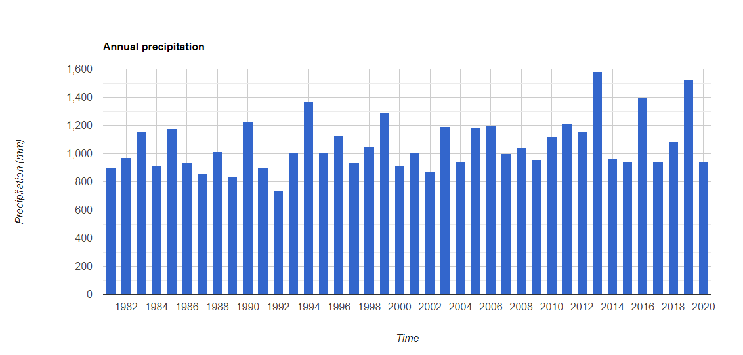
Examples of Large dataset processing
With just few lines of codes
Long term (1981-2020) annual rainfall of Madhya Pradesh

Slide 21
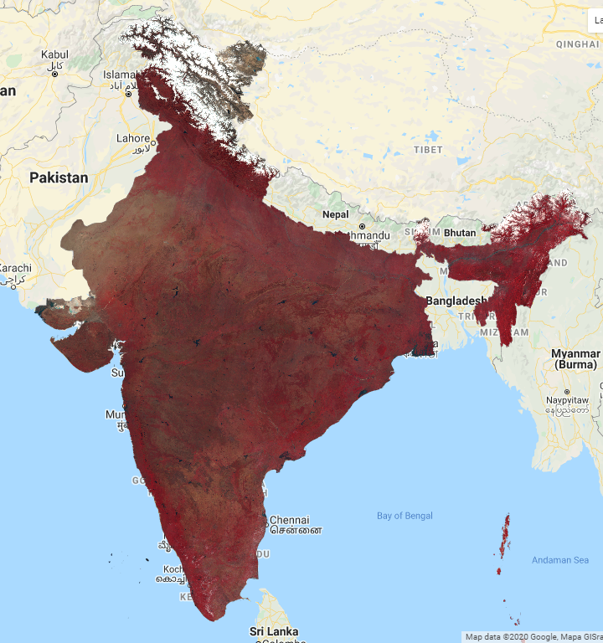
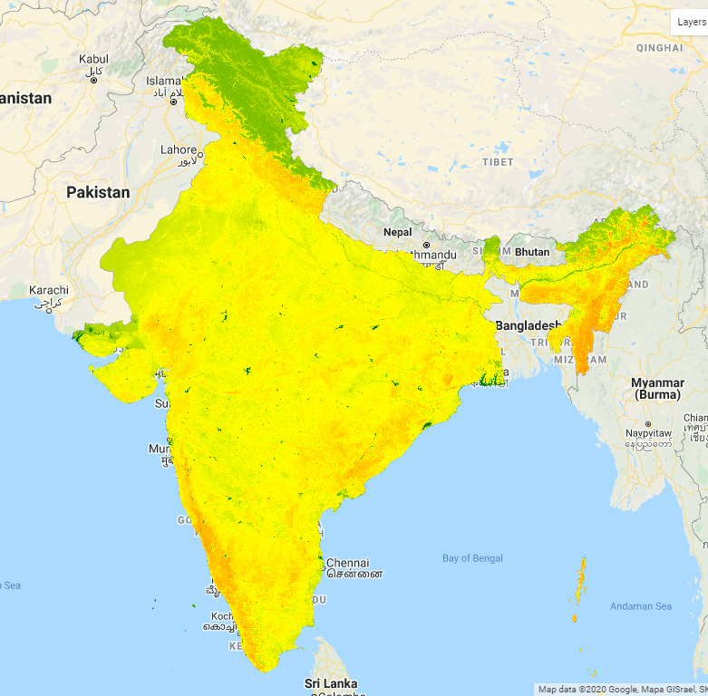
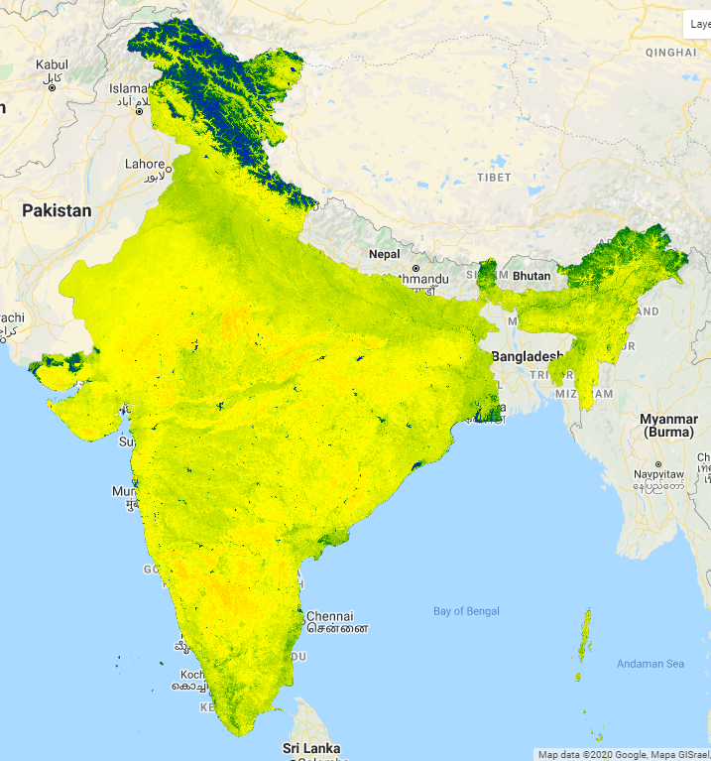
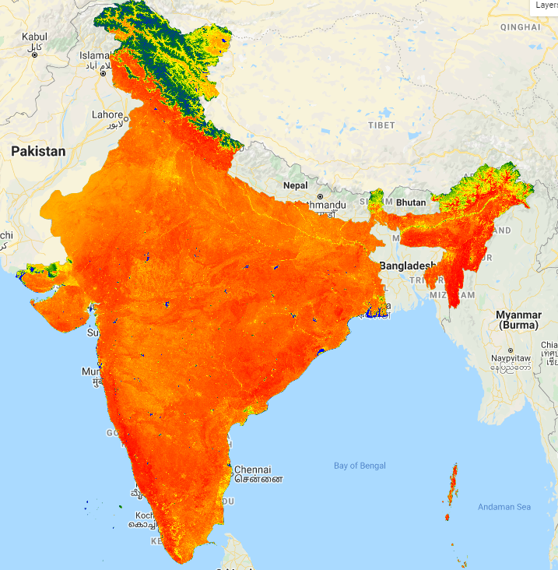
Examples of Large dataset processing
With just few lines of codes
Surface Water Indices
Landsat 8
NDWI
MNDWI
WRI

Slide 22
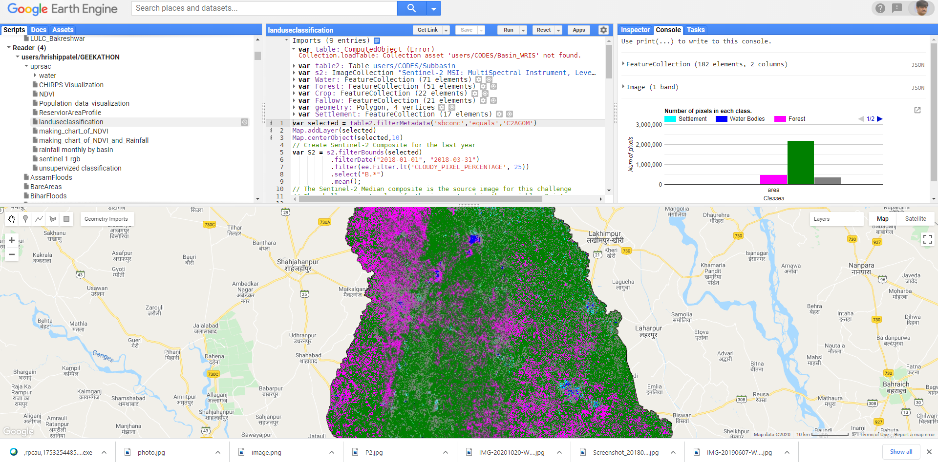
Landuse Classification using GEE

Slide 23
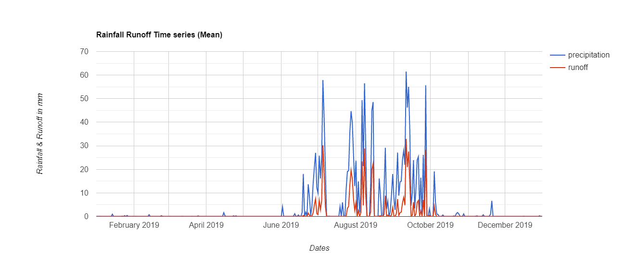
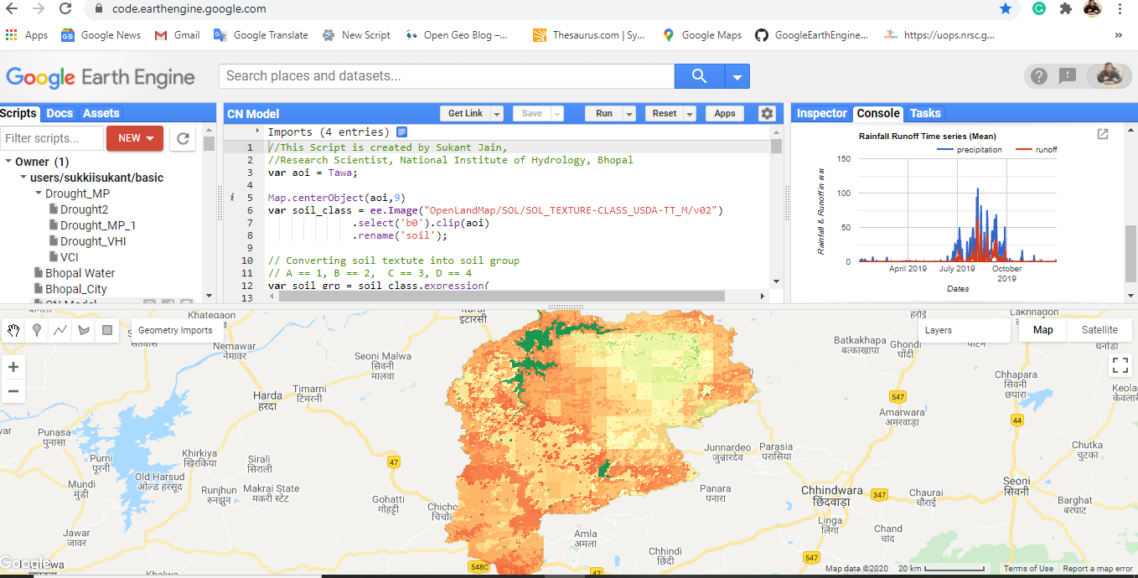
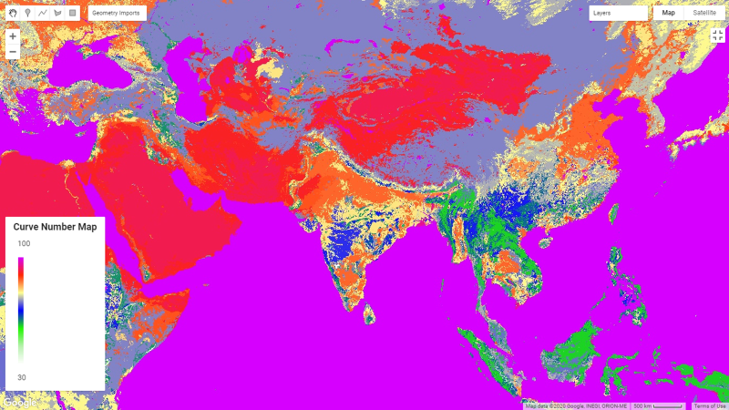
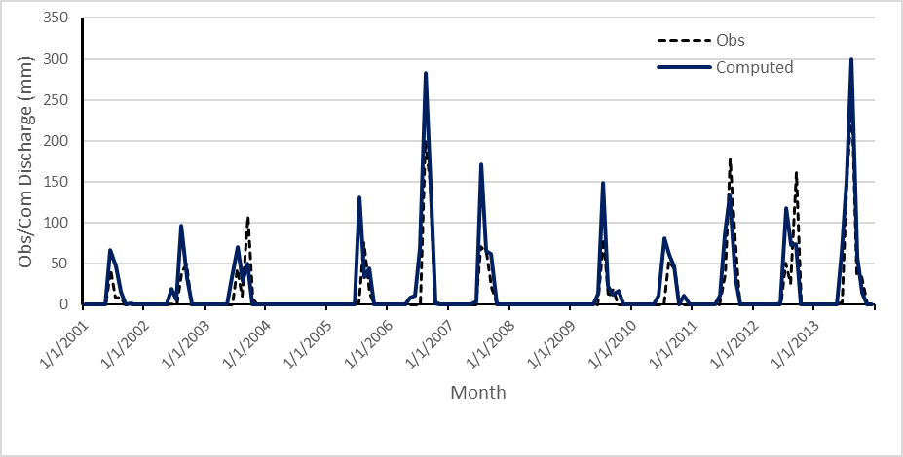
Rainfall Runoff Modelling using SCS-Curve Number Method
Data used
Soil Textutre Data: OpenLandMap Soil texture class (USDA system)
LULC Data: MODIS Land
Daily Rainfall data: climate Hazards Group InfraRed Precipitation (CHIRPS)
Rainfall-Runoff (Mean) Time series at Shipra Catchment for 2019
Monthly Observed vs Computed discharge Time series at Shipra Catchment
Global Curve Number II Map

Slide 24
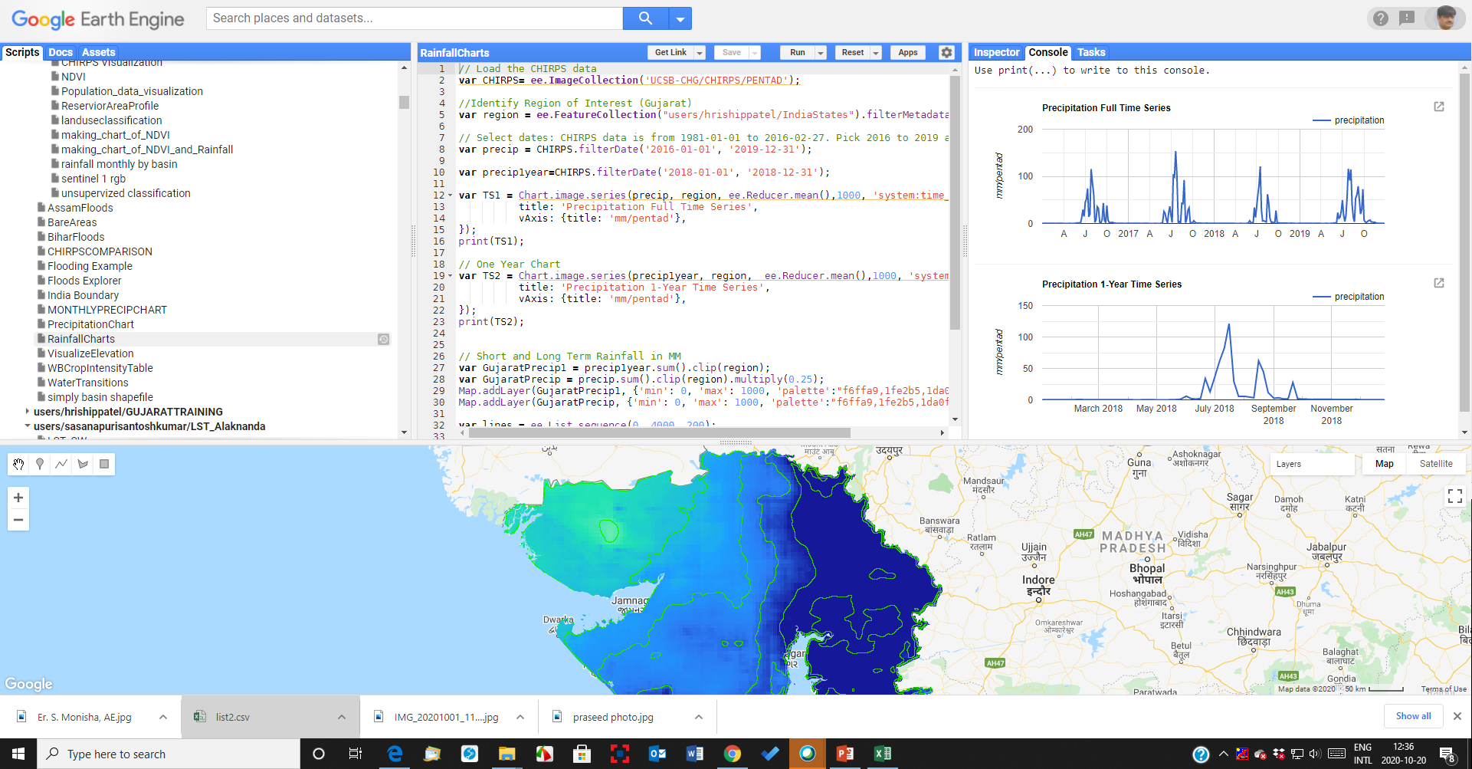
Precipitation Analysis of Gujarat using CHIRPS data 2016-2019

Slide 25
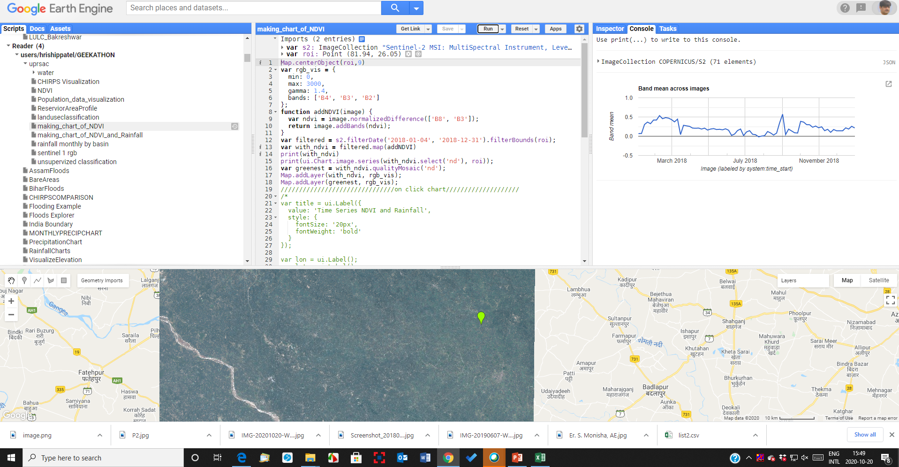
Preparation of NDVI Chart from Sentinel data - Varanashi

Slide 26
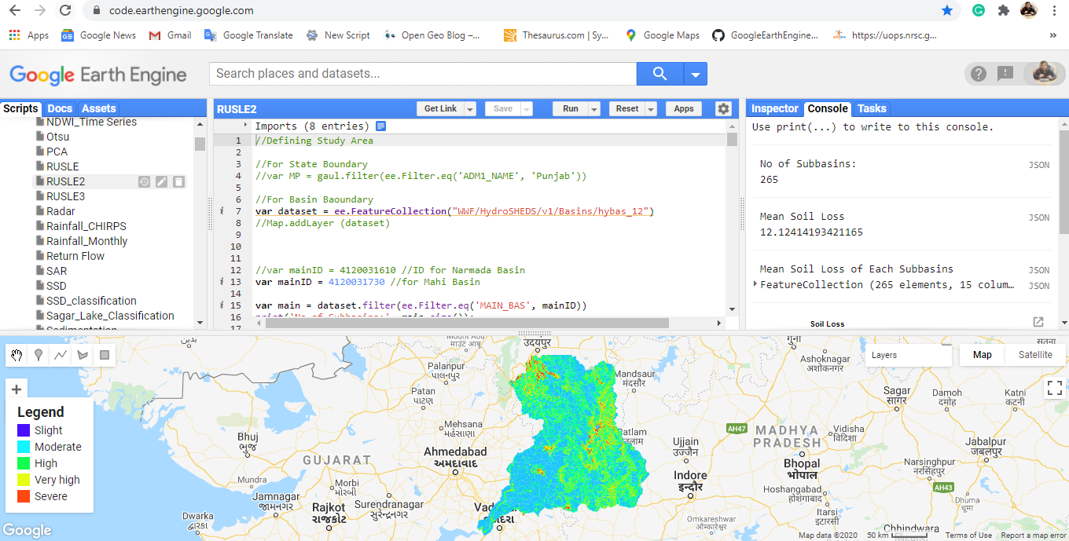
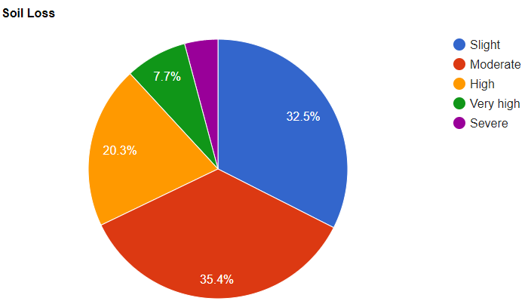
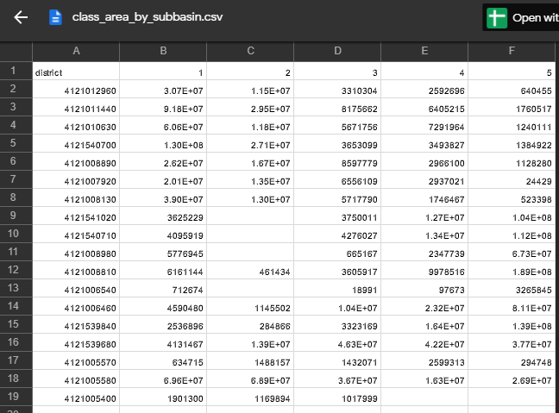
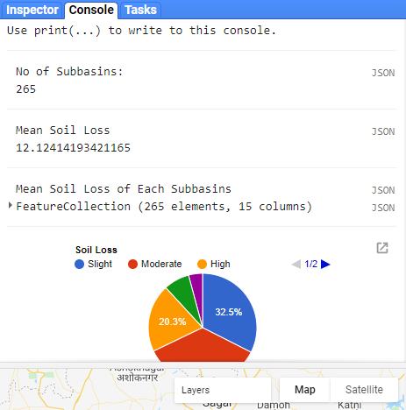
Estimation of Soil Loss using RUSLE
Pie Chart Representing severity of soil loss in Mahi Basin
Average Soil loss of Mahi Basin in Console Panel
Table showing area (meters sq.) of 5 classes of all the 265 subbasins

Slide 27
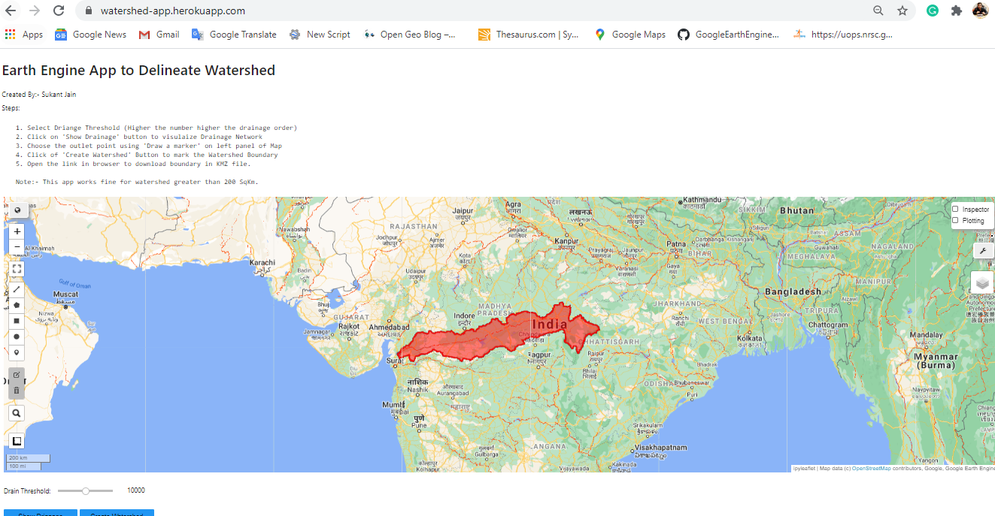
Watershed Delineation App
Created at NIH
https://watershed-app.herokuapp.com/
Earth Engine App to Delineate Watershed is created at NIH
Uses WWF HydroSHEDS Basins level 12 available in GEE.
GEE Python API with other someother powerful libraries like numpy, pandas, ipywidgets, geemap
User can delineate a watershed by defining outlet point
KML file of watershed can be assessed via link generated.
Narmada Basin delineated through watershed App

Slide 28

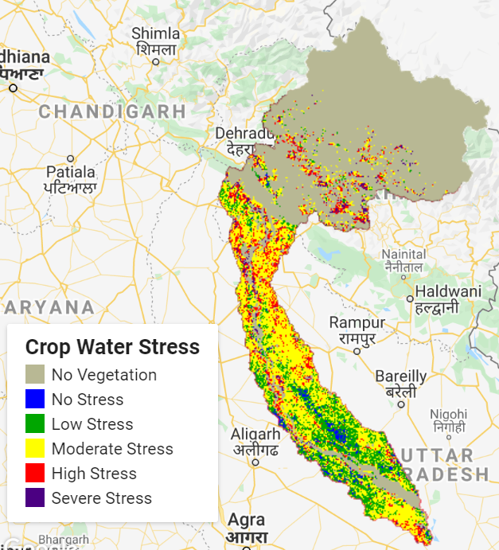
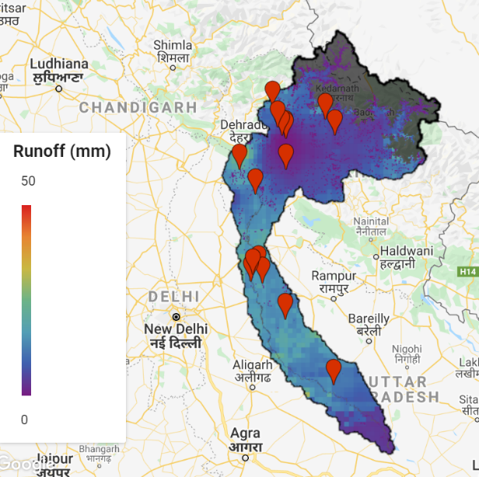
Agriculture related WORK in google earth engine
IRRIGATION SCHEDULING
&
RUNOFF MODELLING
Irrigation Scheduling derived through modelling from satellite imagery.
Runoff Modelling in canal management through modelling from satellite imagery for canal commands

Slide 29
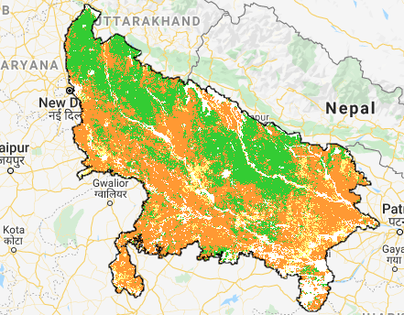
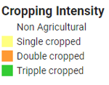
Cropping Intensity from Google Earth Engine

Slide 30
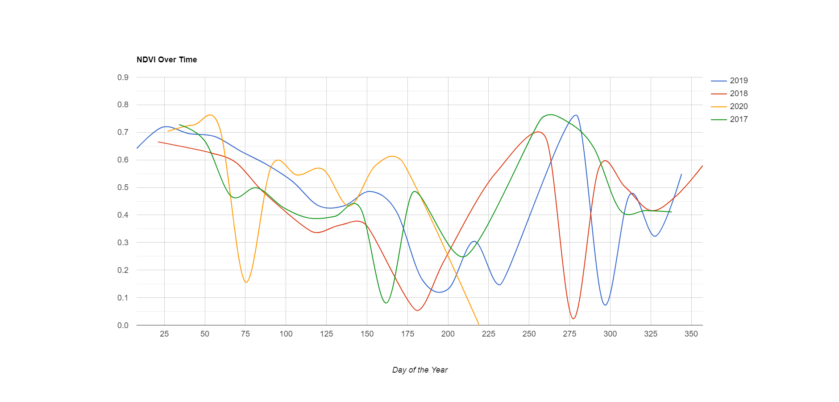
NDVI Trend

Slide 31
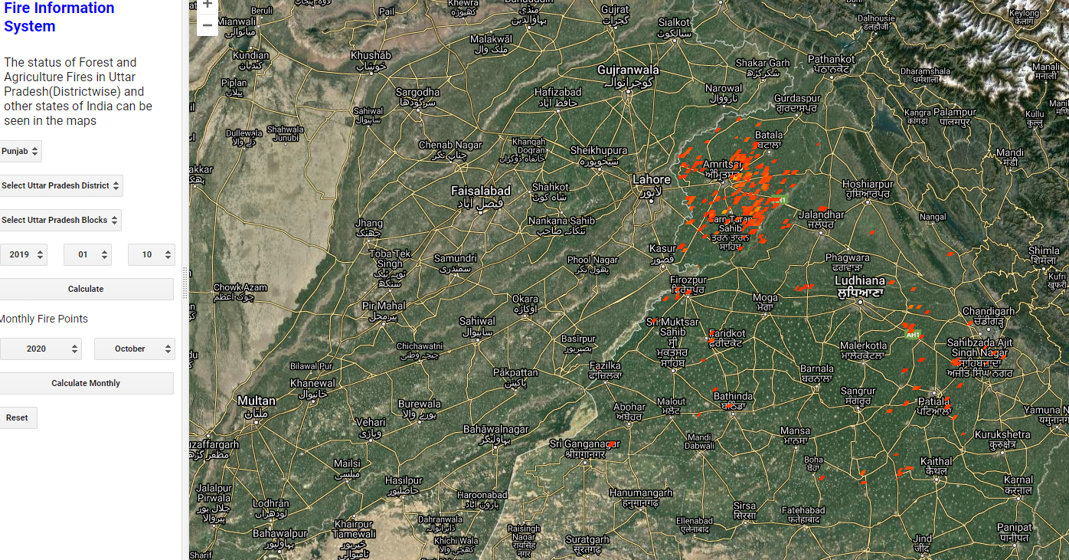
Fire Information System and below depicting fire in month of October 2020

Slide 32
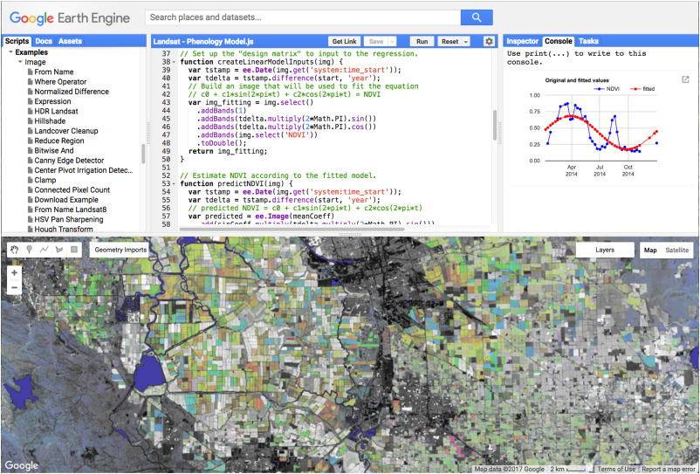
Temporal RGB Generation For Identifying various crops

Slide 33
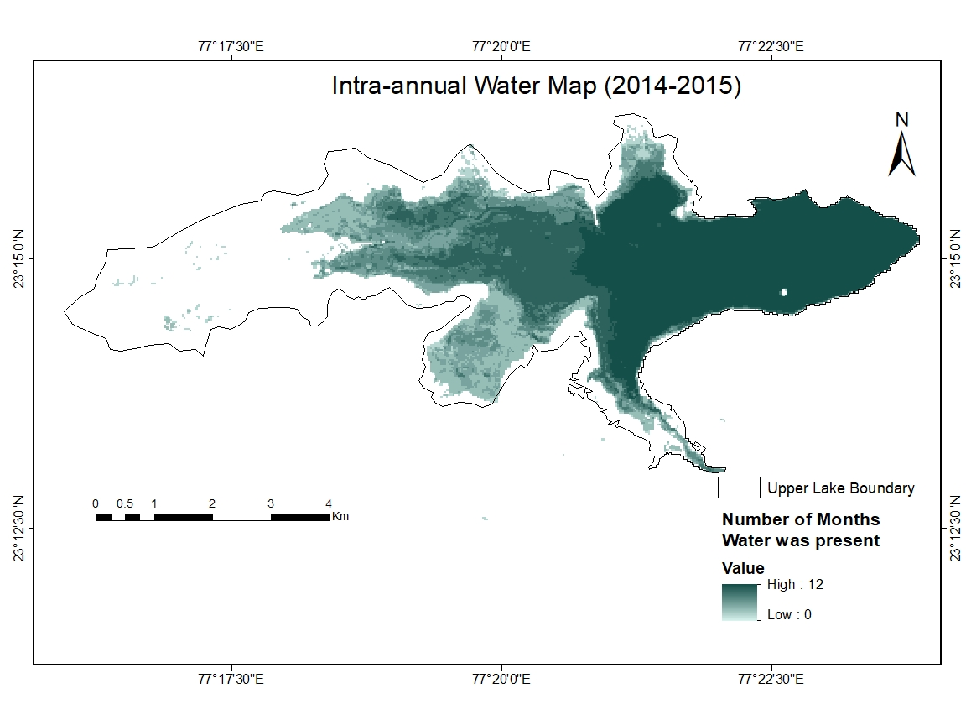
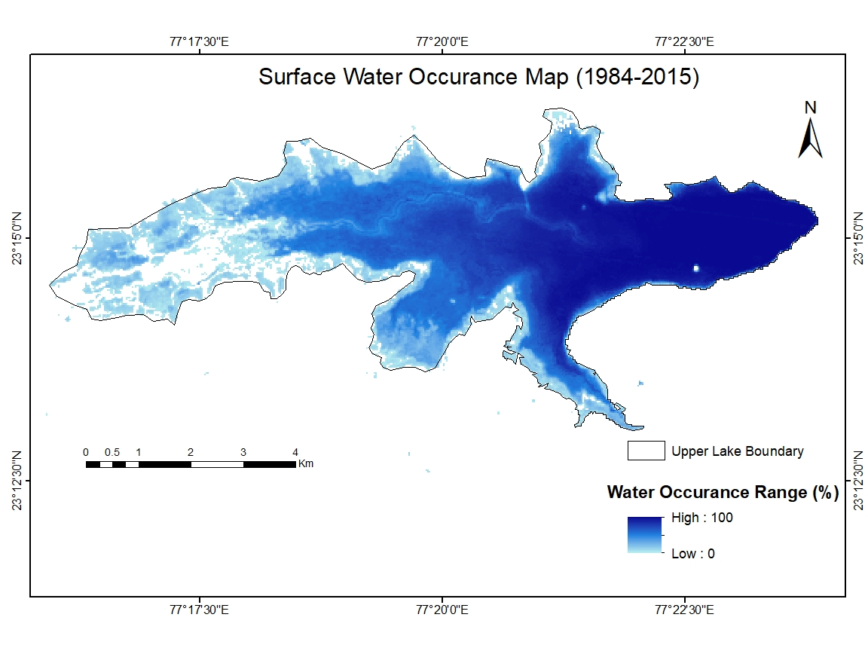
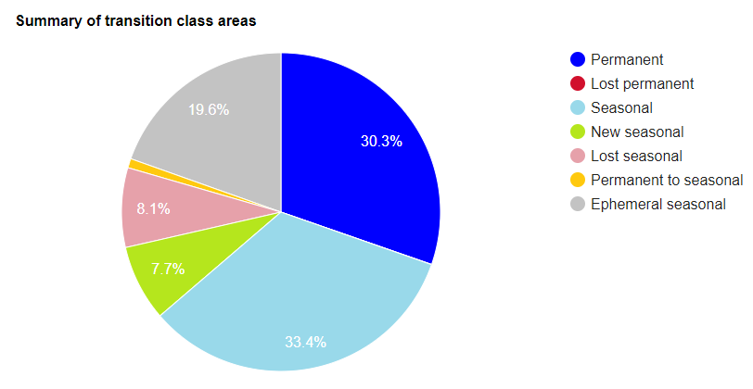
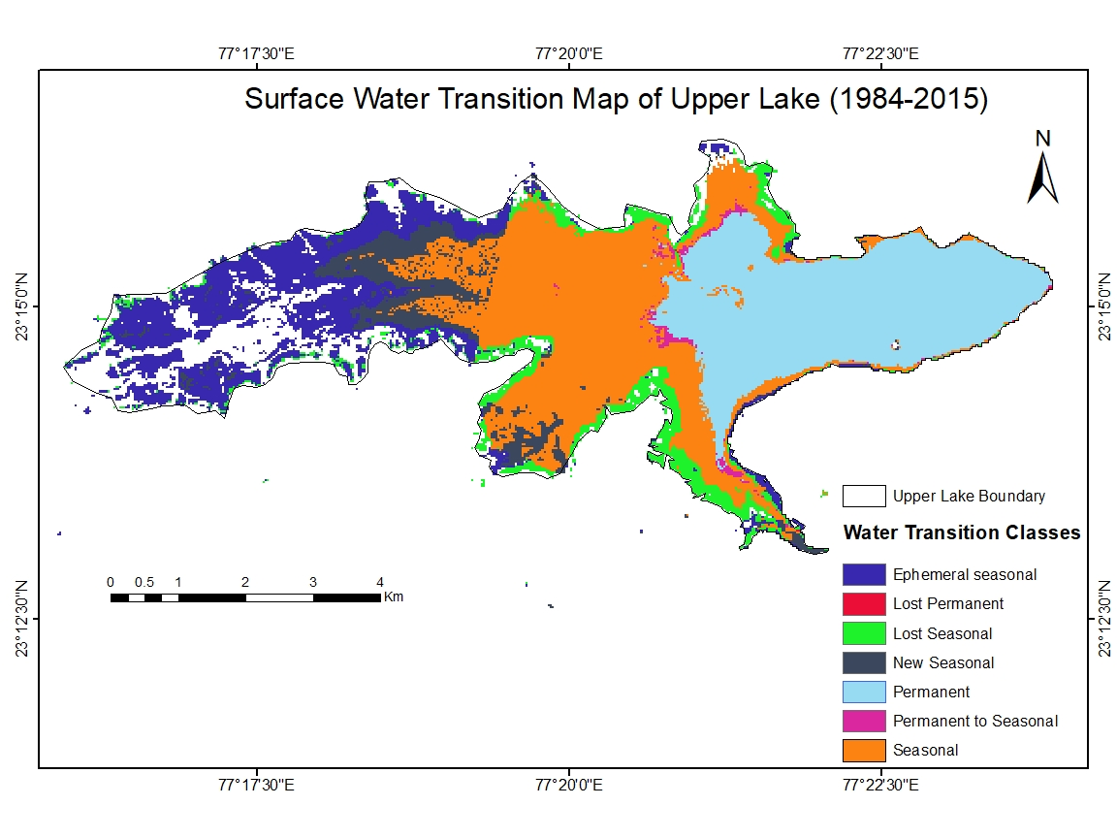
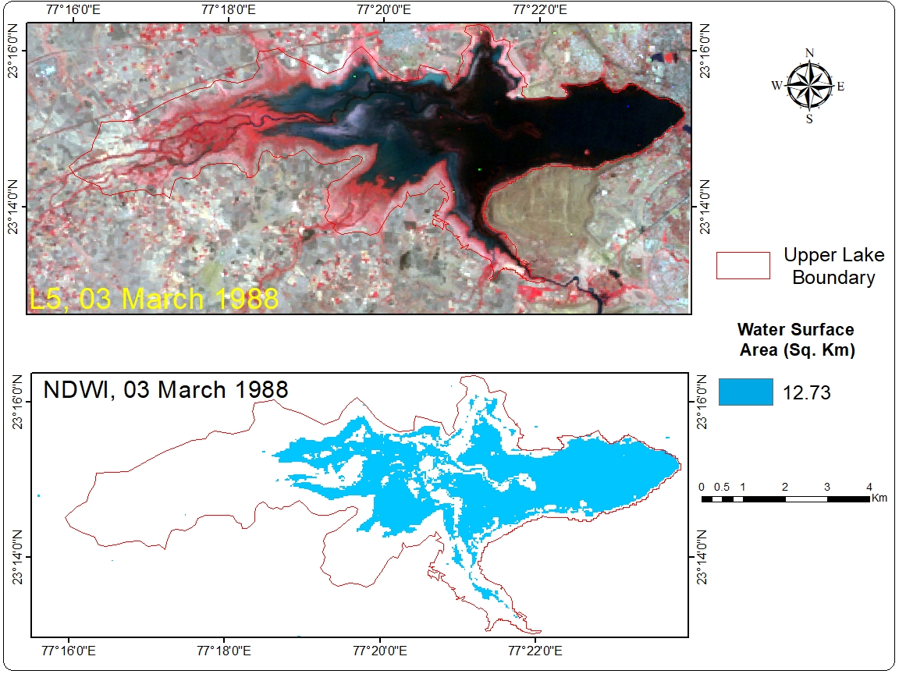
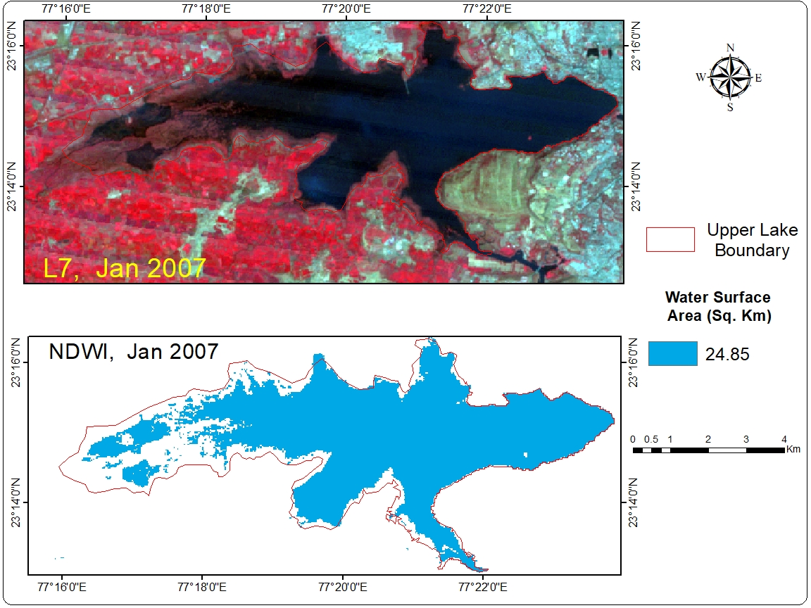
Surface Water Dynamics of Bhopal Lake
Using Landsat & JRC Global Surface Water Mapping Layers, v1.0

Slide 34
Land Use Dynamics of Bhopal City
Methodology
Four dates were selected i.e. 17-12-1990, 26-12-1999, 09-11-2011 (Landsat 5)and 28-11-2018 (Landsat 8).
Identification of classes and creating training datasets. In present study Bhopal city broadly divided into four classes i.e. built-up, water bodies, vegetation, and others
Selection of classification technique. Machine learning technique Classification & Regression Tree (CART) is selected in the study.
Estimation of overall accuracy and kappa coefficient for accuracy assessments.
Jain. S. et.al. (2019)

Slide 35
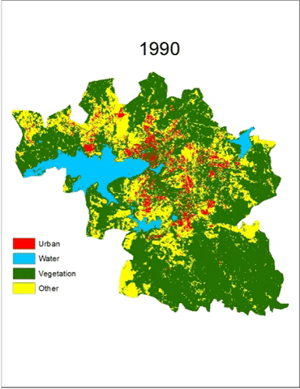
Land Use Dynamics of Bhopal City (contd…)
Results
The values of overall accuracy and kappa coefficient ranging from 0.88 to 0.93 for Classification and Regression Tree classifier.
Classes | 1990 | 1999 | 2011 | 2018
Settlement | 21.73 | 72.66 | 82.32 | 109.46
Water Body | 34.78 | 31.77 | 29.04 | 26.93
Vegetation | 258.41 | 205.99 | 193.18 | 182.29
Open Area | 99.98 | 104.48 | 110.36 | 96.21
Jain. S. et.al. (2019)

Slide 36
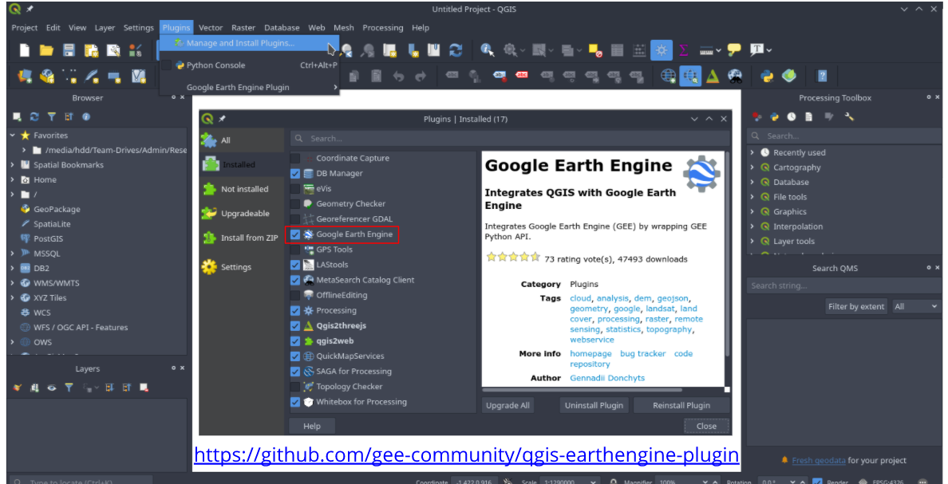
QGIS Google Earth Engine plugin

Slide 37
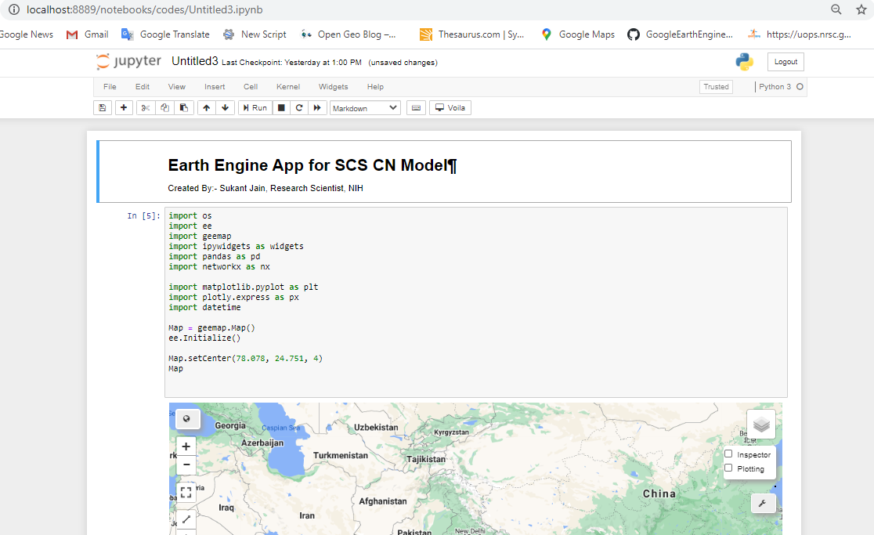
Google Earth Engine Python API in Jupyter Notebook

Slide 38
The application of GIS is limited only by the imagination of those who use it
~ Jack Dangermond
Thank You

